Slide 1
STATISTICAL INFERENCE AND QUALITY CONTROL FOR MICROSURGERY STUDY TEAM 12
Swetcha Chowdary Karnati
Praveen Burra
Navya Doddapaneni

Slide 2
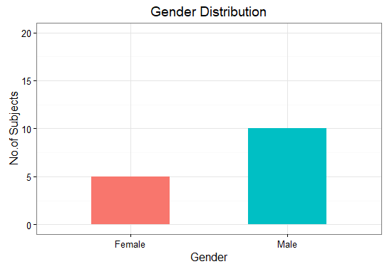
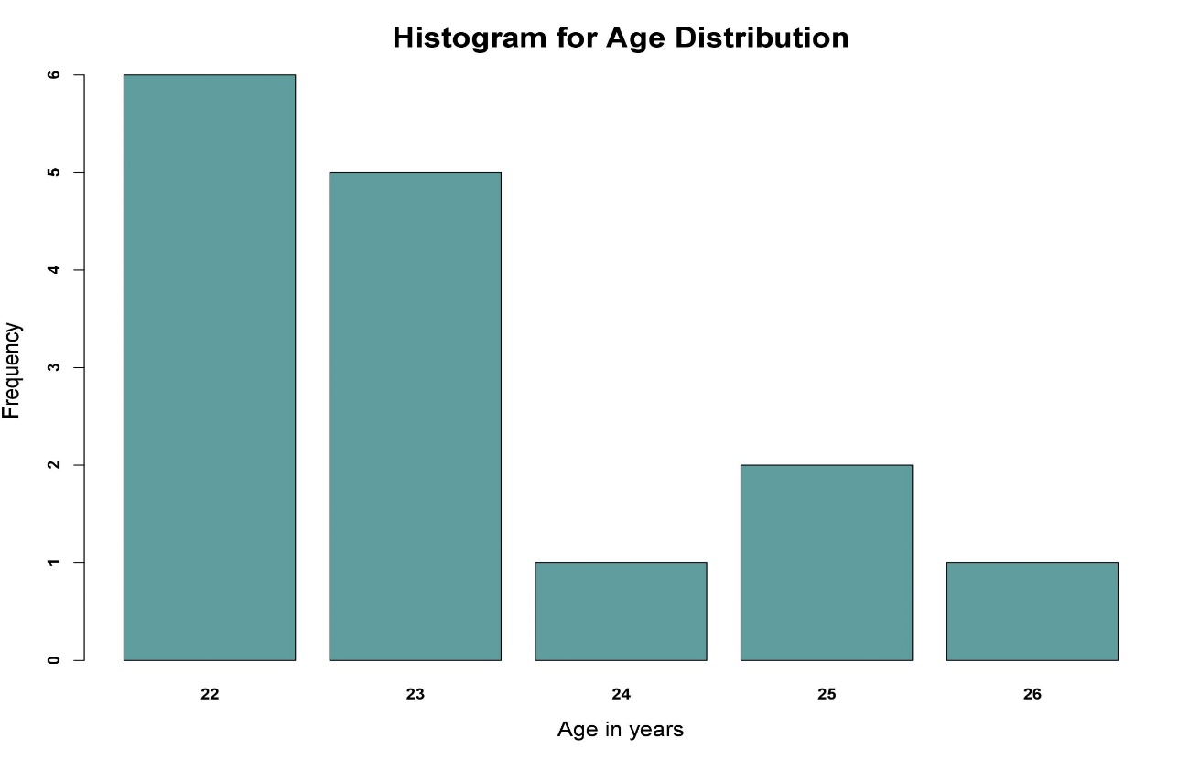
1. Biographic Data :
5 Female and 10 Male Subjects participated in the Microsurgery Study.
The subjects mainly belong to 22 years(6) and 23 years(5).
The average age of the Subjects is found out to be 23 years (approx).
The oldest person participated has 26 years.

Slide 3
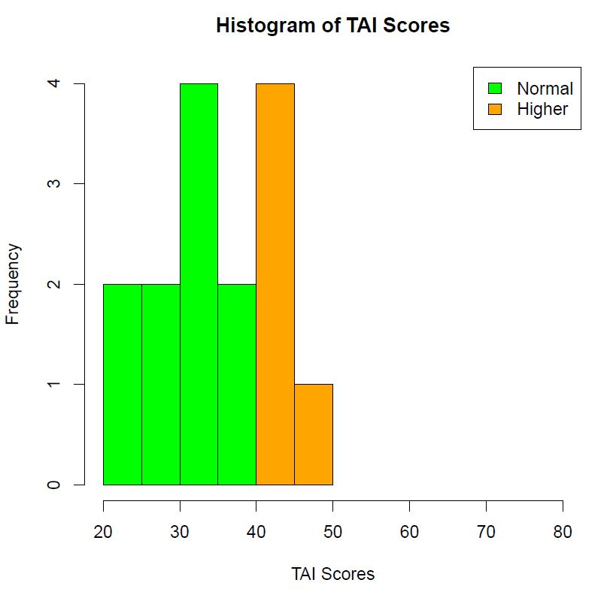
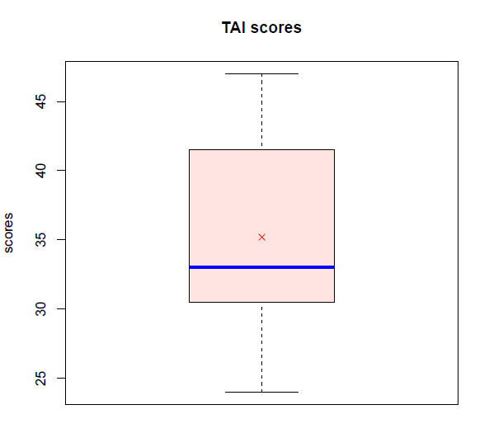
2. Trait Psychometric Data :
10 Subjects with TAI scores less than 40 and 5 with TAI scores in range of 40 and 50.
The mean of TAI scores is 35.2 and Standard Deviation is 7.09

Slide 4
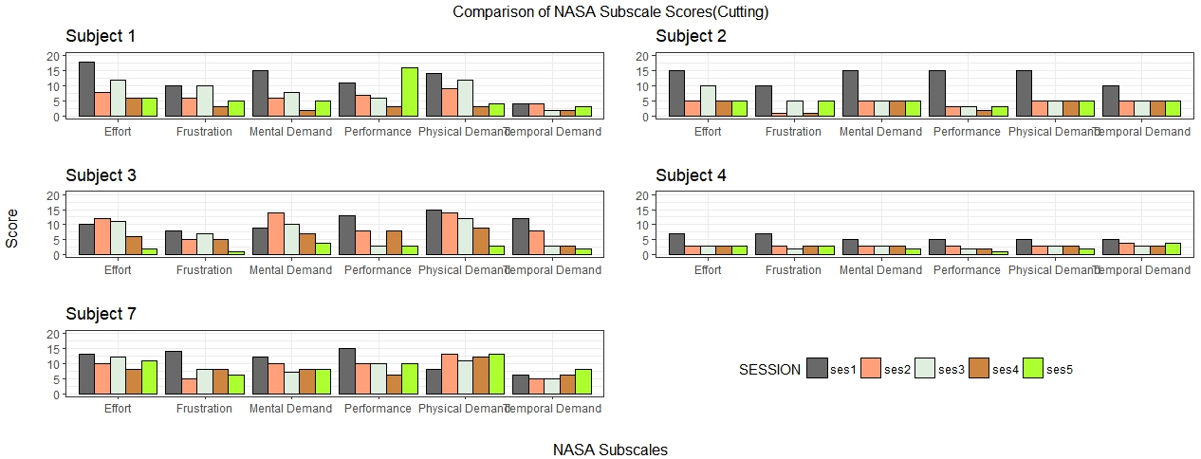
3. State Psychometric Data:

Slide 5
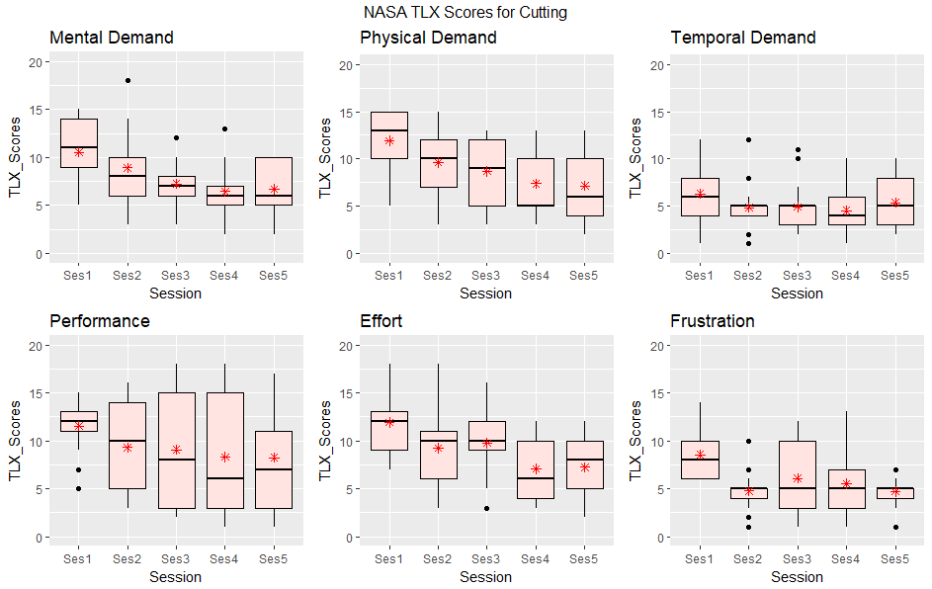
BOXPLOTS showing NASA TLX_Scores for different NASA Subscales over Sessions: Cutting

Slide 6
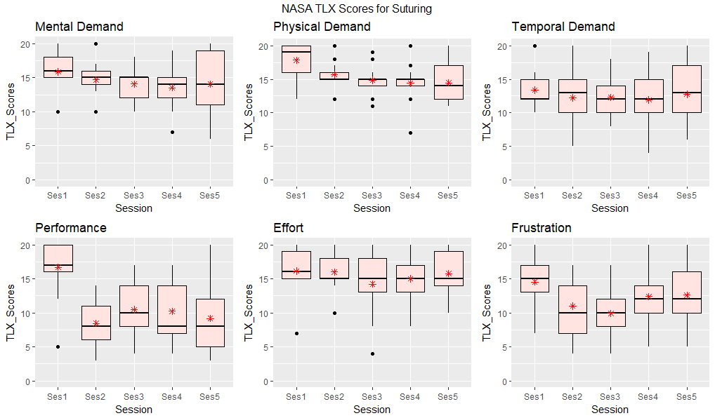
BOXPLOTS showing NASA TLX_Scores for different NASA Subscales over Sessions: Suturing

Slide 7
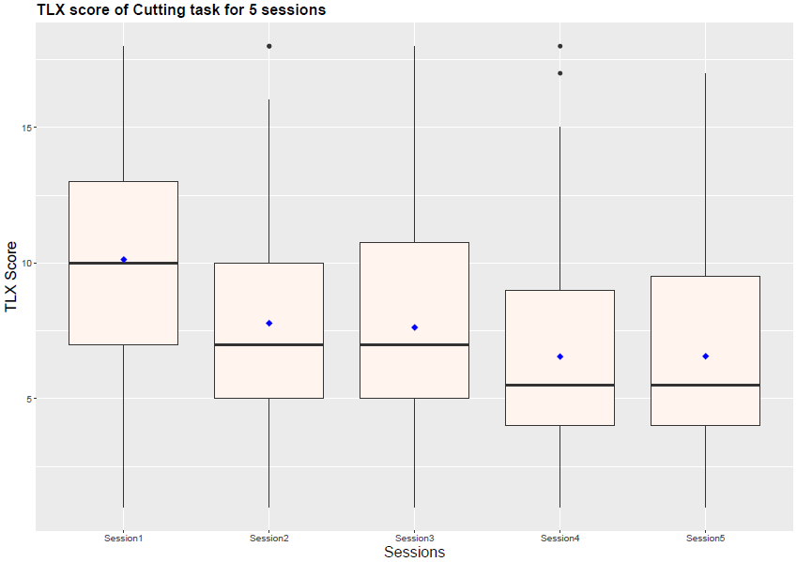
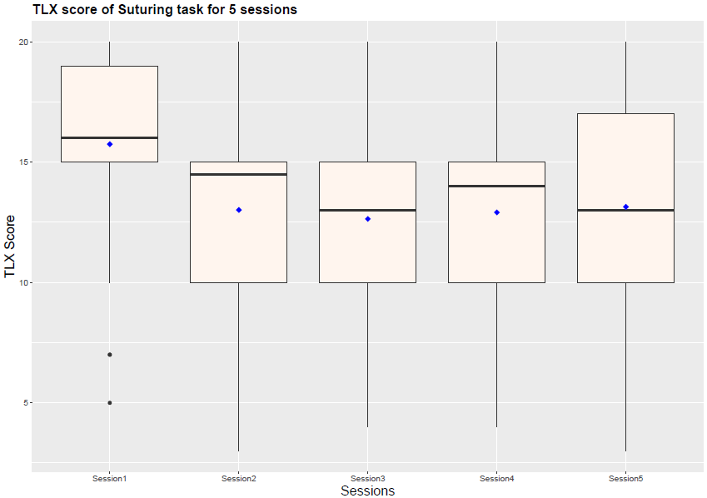
Boxplots for NASA_TLX Score over Sessions: Cutting & Suturing

Slide 8
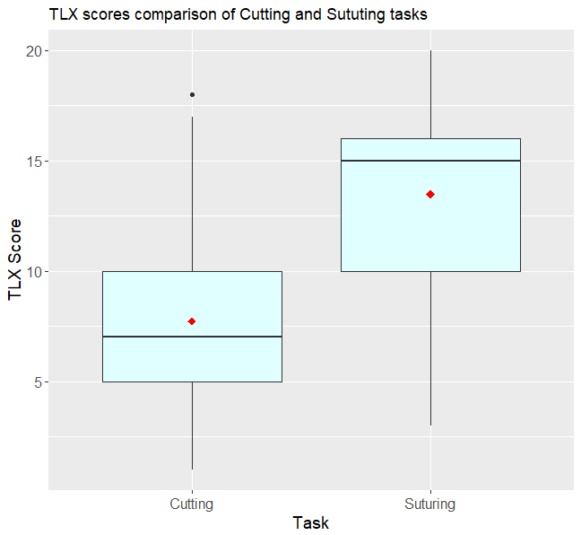
Boxplots for NASA_TLX Scores for Cutting and Suturing:

Slide 9
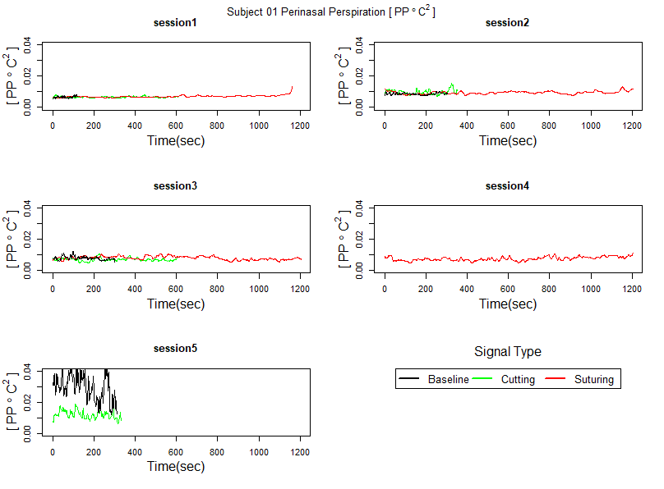
4. Perinasal Perspiration (Stress) Signal Data:

Slide 10
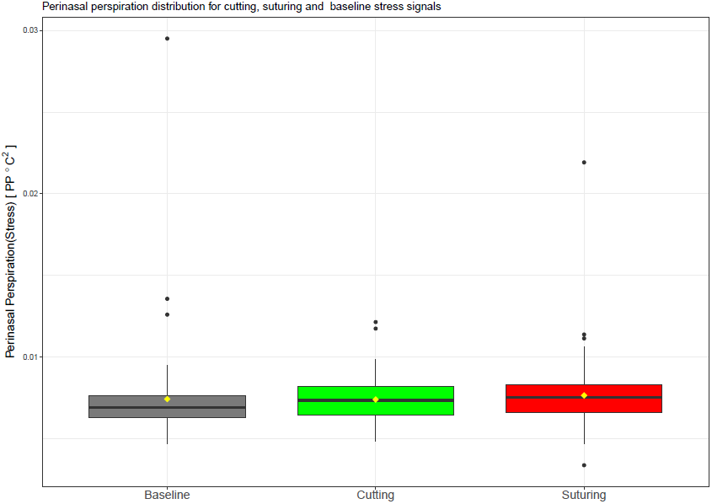
Boxplots showing distribution of different Stress Signals

Slide 11
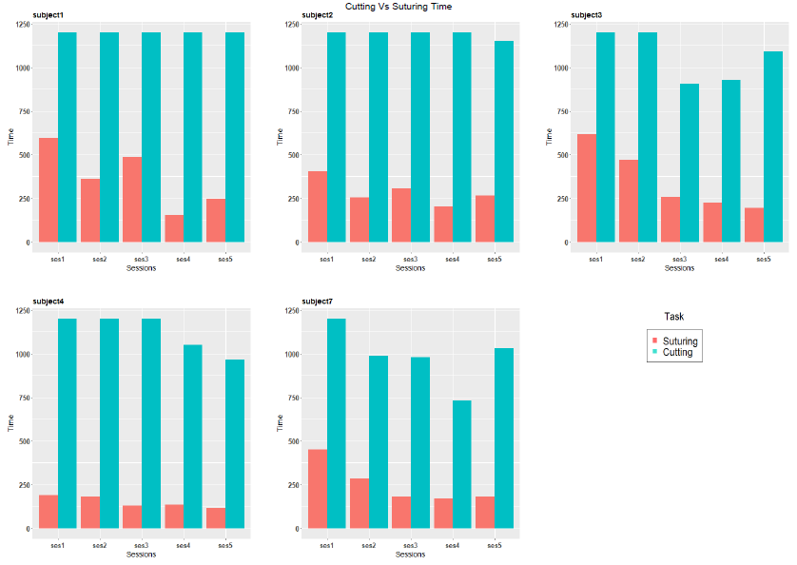
5. Performance Data:

Slide 12
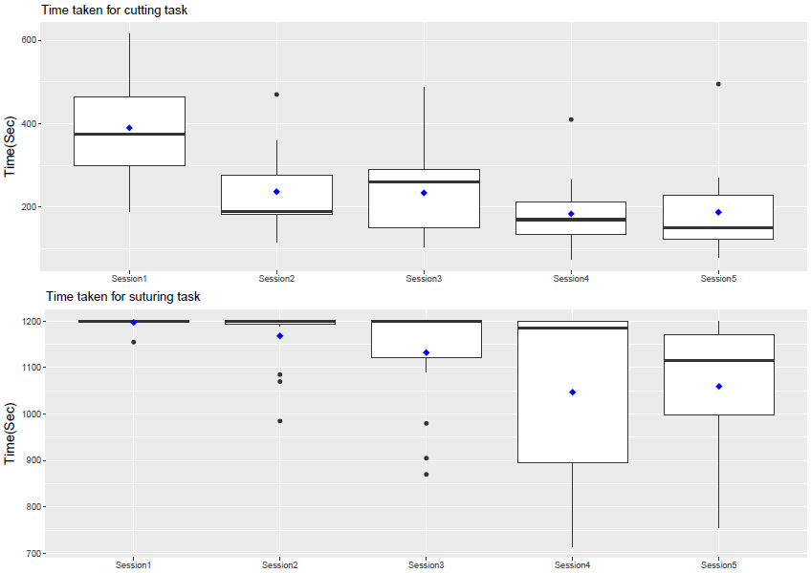
Boxplots showing Time taken for Cutting & Suturing over Different Sessions:

Slide 13
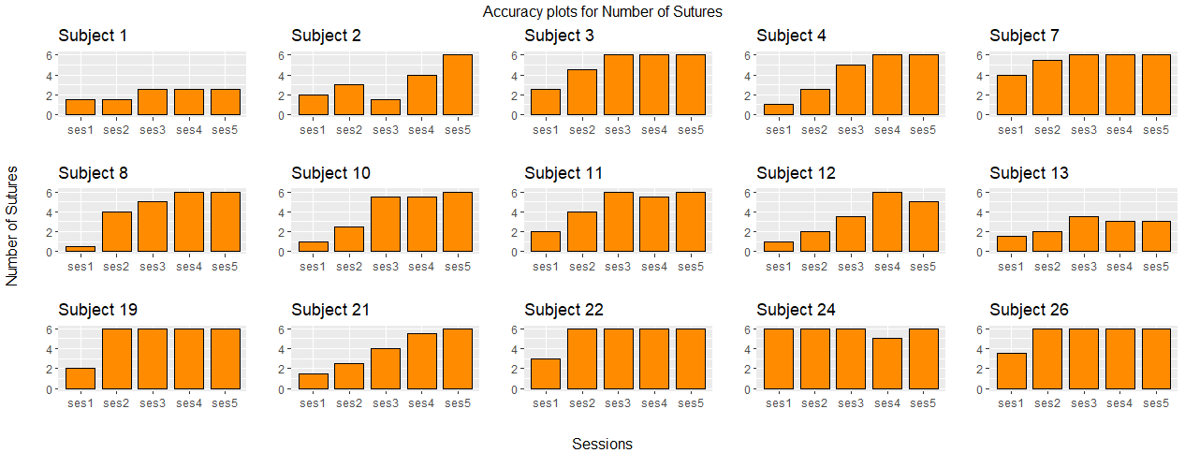
Accuracy plots for Number of Sutures:

Slide 14
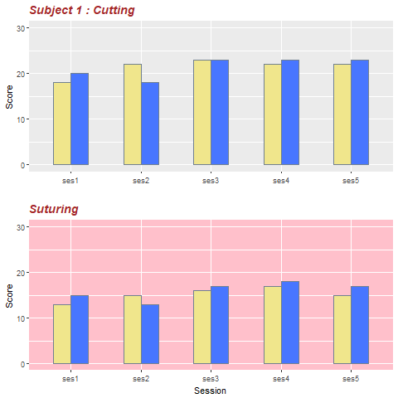
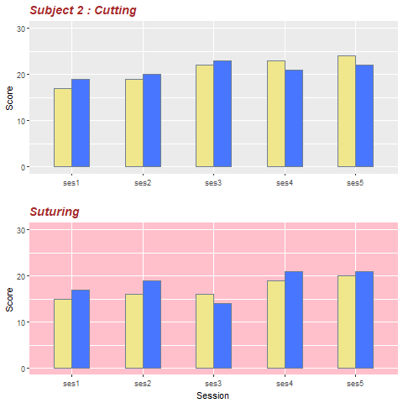
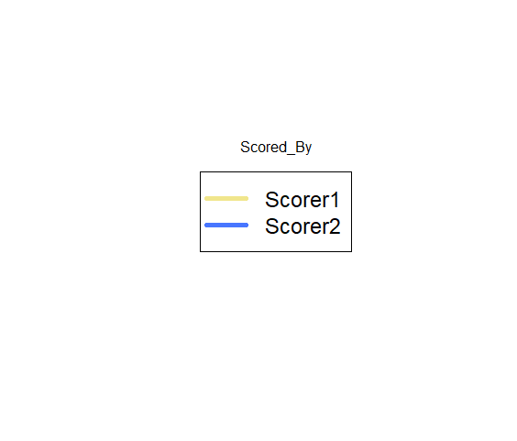
Accuracy plots for Scores over different Sessions: Cutting & Suturing

Slide 15
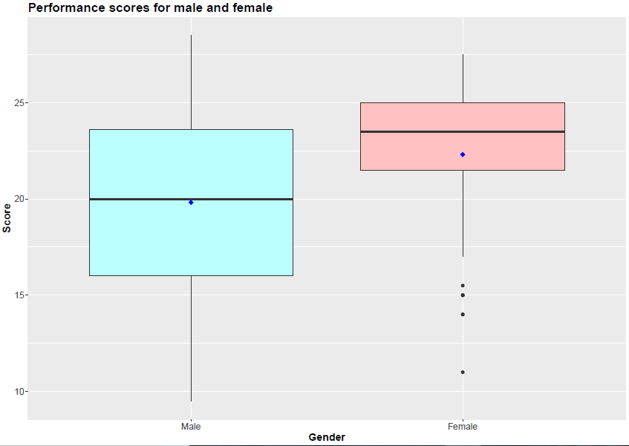
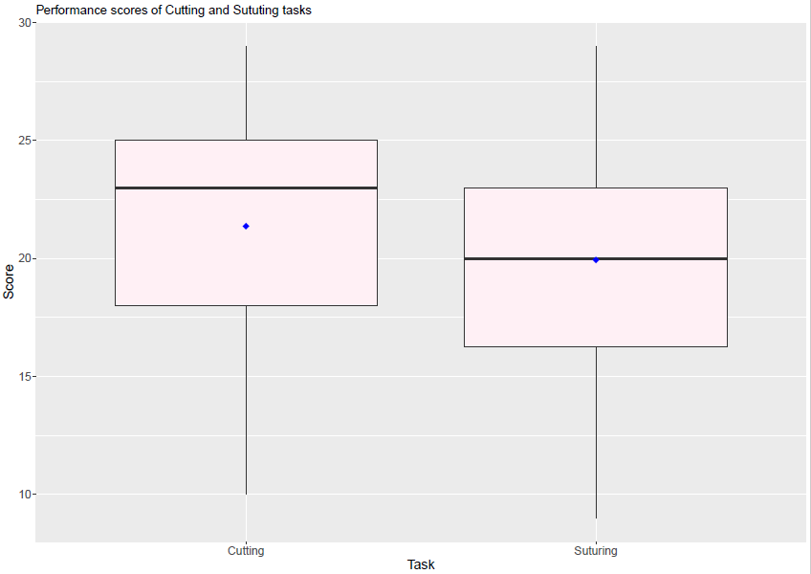
Boxplot showing Performance Scores Variation over Gender & Tasks:

Slide 16
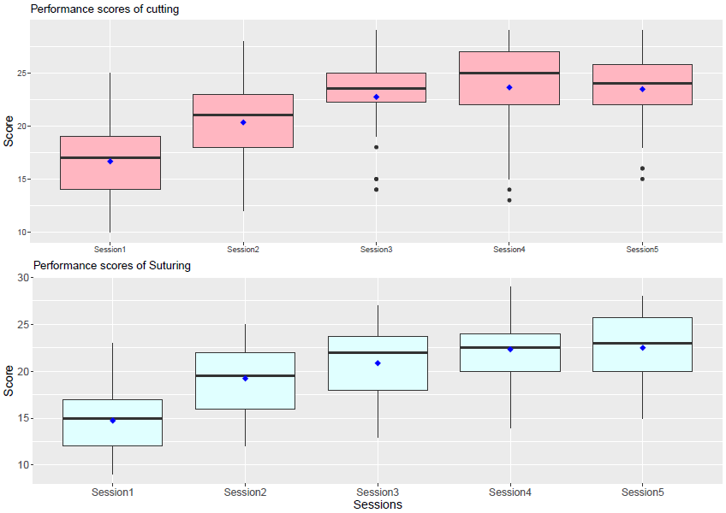
Boxplots for Performance Scores over different Sessions:

Slide 17
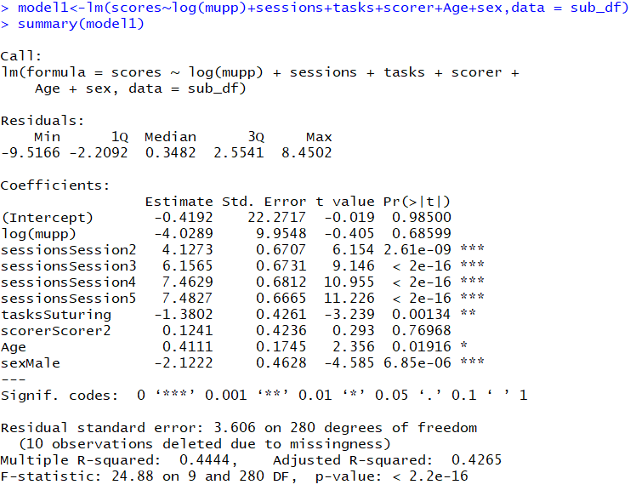
Linear model 1

Slide 18
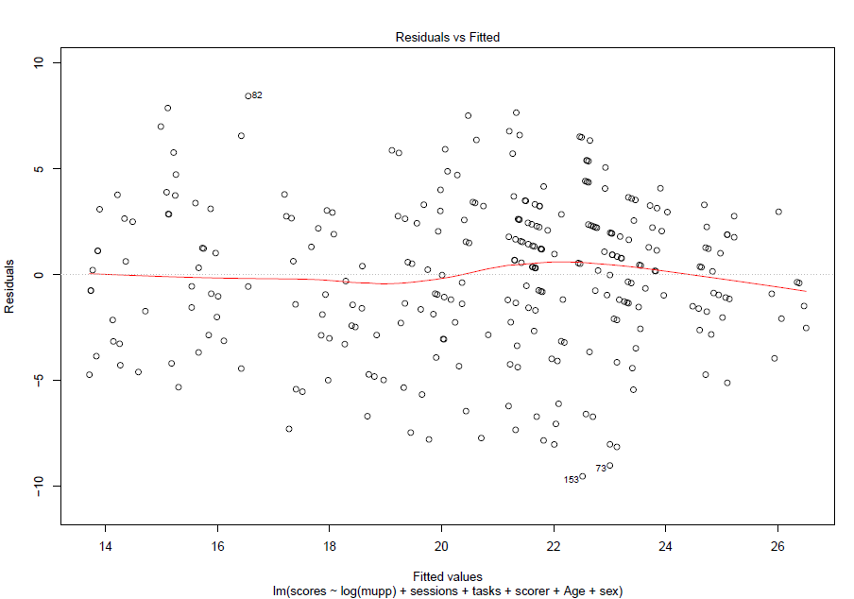
Residual plot of Linear Model:

Slide 19
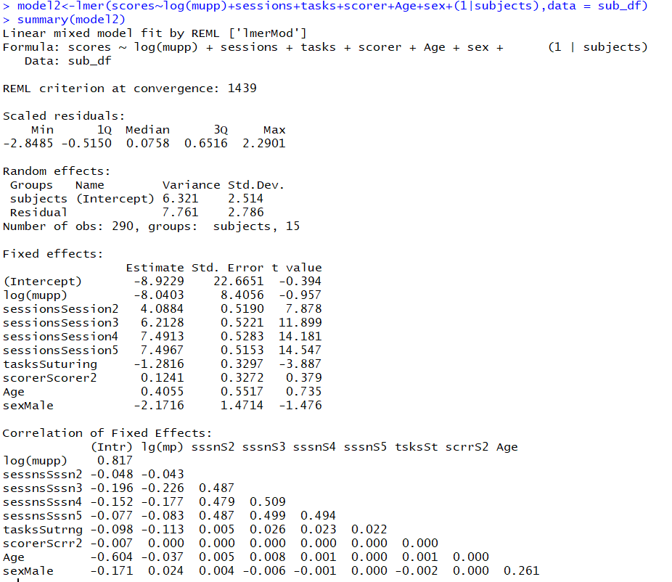
Mixed model(With subject random effect)

Slide 20
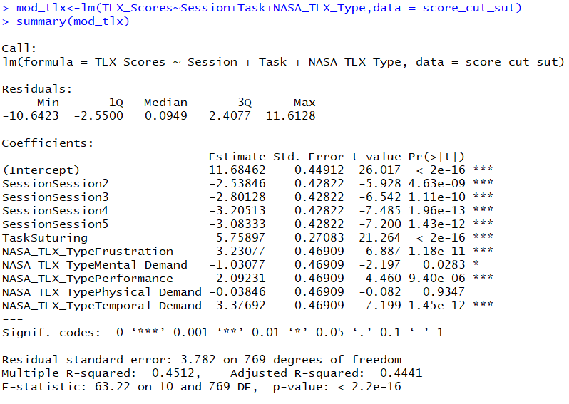
Linear model for NASA TLX Scores

Slide 21
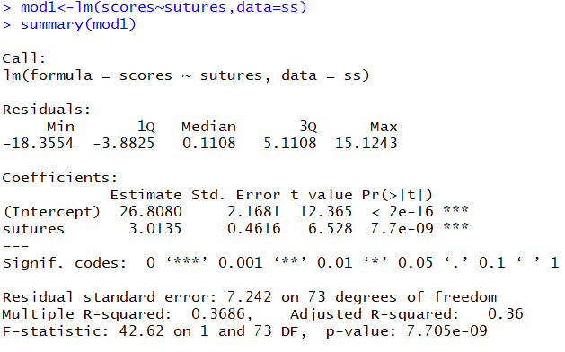
Model for Number of sutures

Slide 22
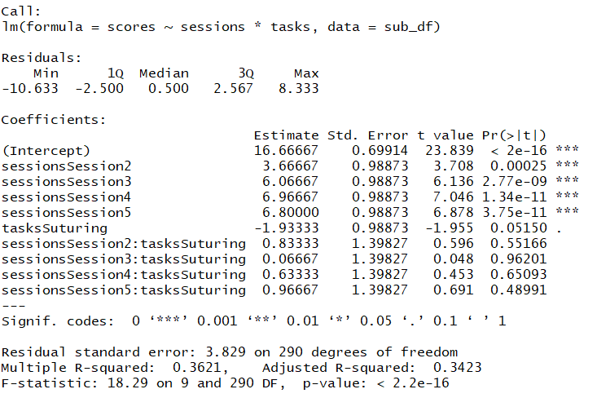
Interaction between sessions and task

Slide 23
Conclusion
After analyzing the linear models and observing the summarizing and quality control plots, it can be observed that the performance scores of the subjects depend on the variable of sessions with an increase in the performance scores as the session increases. This indicates that the subjects have an improvement in performance of the microsurgical tasks with increase in practice sessions involved. This increase in the performance scores over sessions is observed to be high initially but remained fairly constant after session 4 which shows that there is a maximum performance score which could be reached with practice sessions after which the scores remain fairly constant.
Also, with the increase in the number of sessions it is observed that there is a decrease in the time taken for performing the cutting and suturing tasks. This indicates that besides proficiency, speed of the subject in performing the microsurgery also increases with the increase in number of sessions.
We can also observe that there is a decrease in the NASA TLX subscales scores indicating that the subjects feel less physical demand, mental demand, frustration, effort and temporal is required for the task as the lab practice sessions increases. This indicates that the subjects perceive the workload as less of a burden.
The variable of age does not play any significant role in determining the performance scores indicating that the age of the subject is not an important factor in determining the performance of the subjects.
It is observed from the linear model and summarizing plot that the task of suturing has less performance scores compared to the suturing task. This indicates that the subjects have performed well in the cutting task than suturing task. Interestingly from the figure 9 it can be observed that the NASA TLX scores obtained for the suturing task are higher than the cutting task indicating that the workload as perceived by the subject is higher for the suturing task as compared to the cutting task.
The summarizing plot for the perinasal mean values (figure 10) and the linear model indicates that there is no significant effect of the perinasal perspiration values measured for the subjects on the performance scores.
The summarizing plot and the linear model indicates that the performance scores for the female subjects is higher than the male subjects.
The research indicates that as the practice with the sessions or experience increases, there is an increase in the performance scores and speed of the task performed with a decrease in the work load as perceived by the subject.
Therefore it is important to train the micro surgeon students to observe an increase in the performance, accuracy and speed of the surgeries performed.

Slide 24


Thank you
We would like to thank Dr. Ioannis Pavlidis
and George for teaching and guiding us through out the course.

